Slide 1
Community Basics
Exploring the Browse Function

Slide 2

Located in the top banner, click the arrow next to ‘Browse’

Slide 3

There are three choices: Discussion Posts

Slide 4

Library Entries

Slide 5

And the Glossary

Slide 6
Let’s explore ‘Discussion Posts’ first:

Slide 7
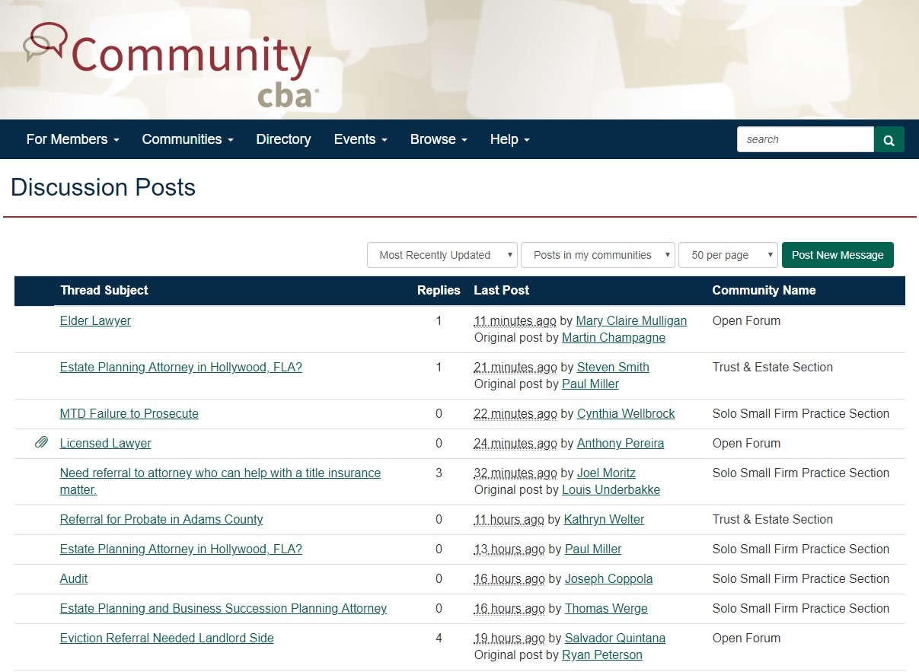

Slide 8

Use to arrow next to the ‘Most Recently Updated’, this gives you the option of changing the order you view the posts in.

Slide 9
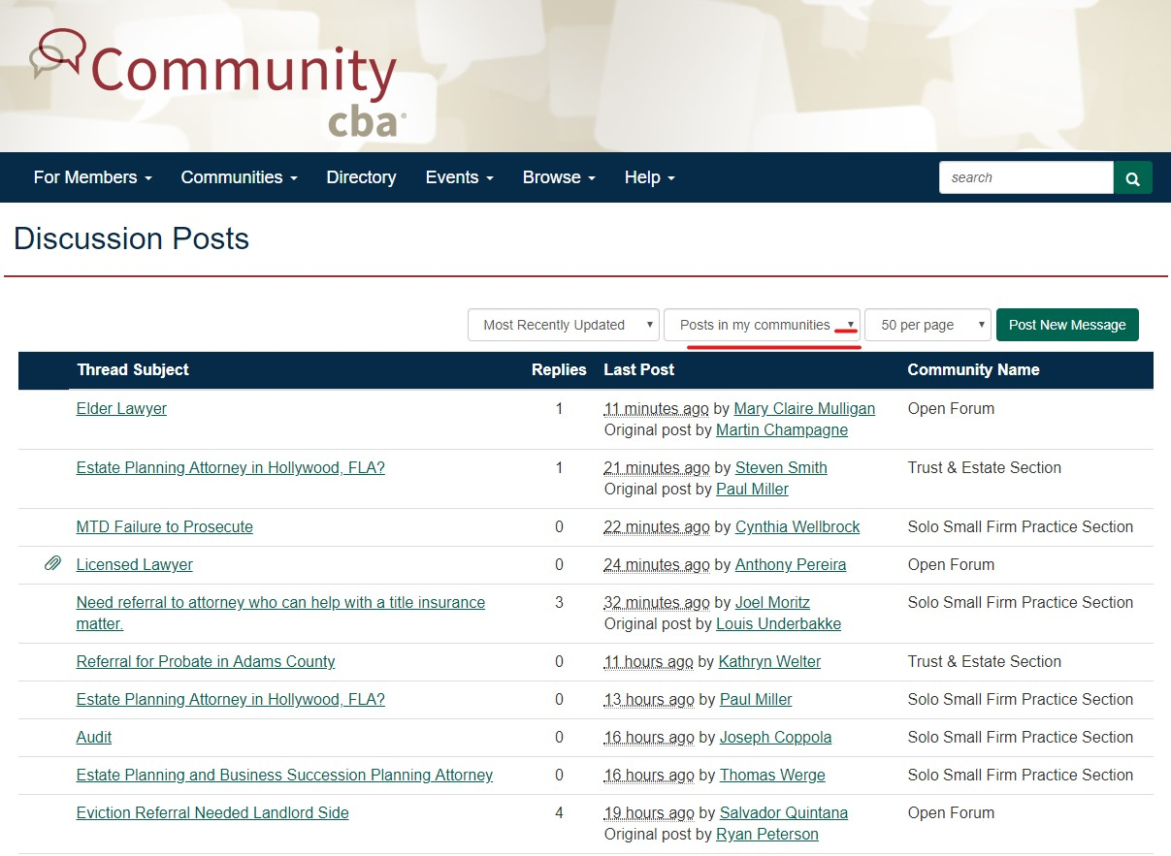
The arrow next to ‘Posts in my communities’ gives you the option of either ‘Posts in my communities’ or ‘All posts I can see’.

Slide 10
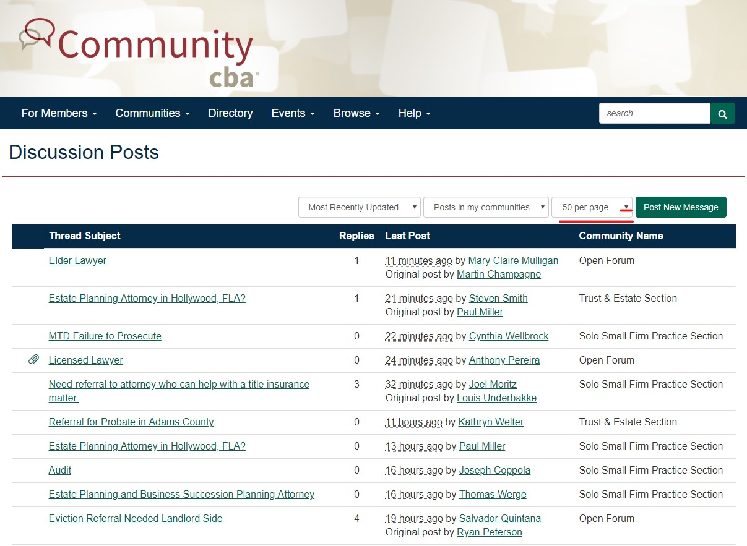
The arrow next to ‘50 per page’ gives you the option to change how many posts you see per page.

Slide 11
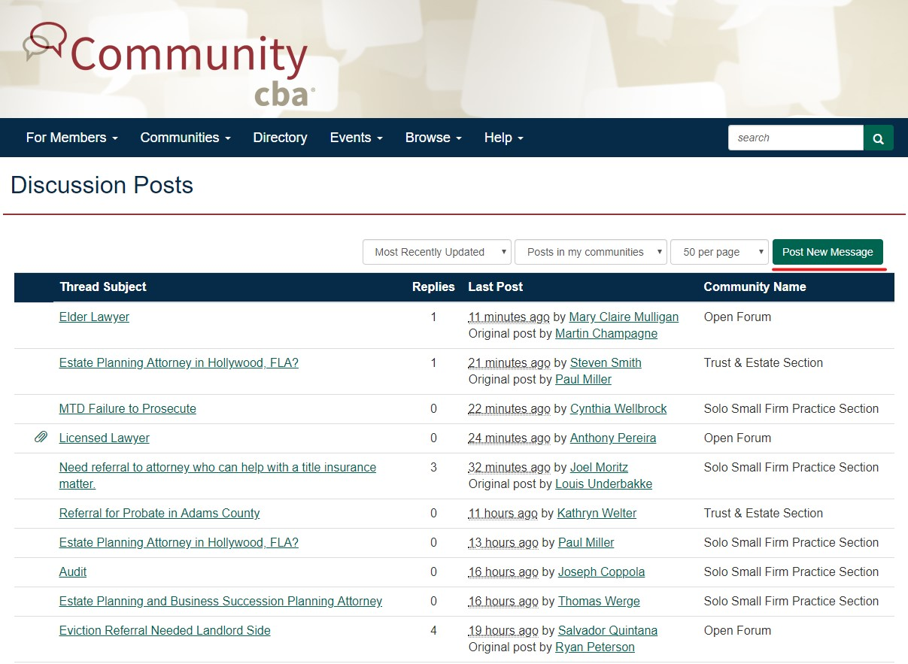
You may also create a new post from here, Click ‘Post’.
For information on posting please see the presentation ‘Community Basics: Posting’

Slide 12
Now to ‘Library Entries’

Slide 13
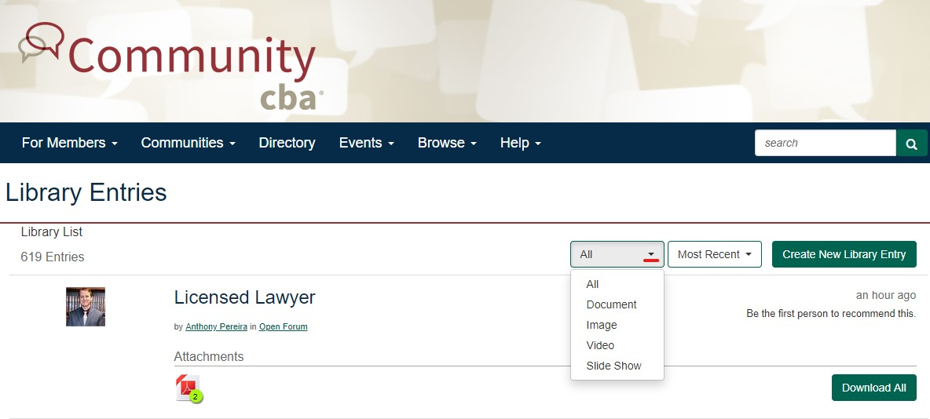
The arrow next to ‘All’ give you the options to choose how you see Library posts.

Slide 14
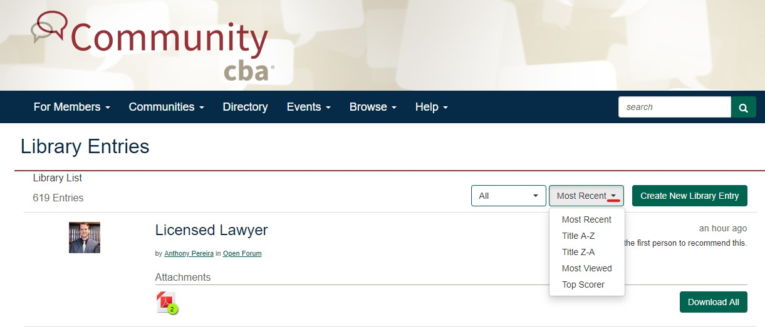
The ‘Most Recent’ box gives you the option of order you’d like to see the posts.

Slide 15
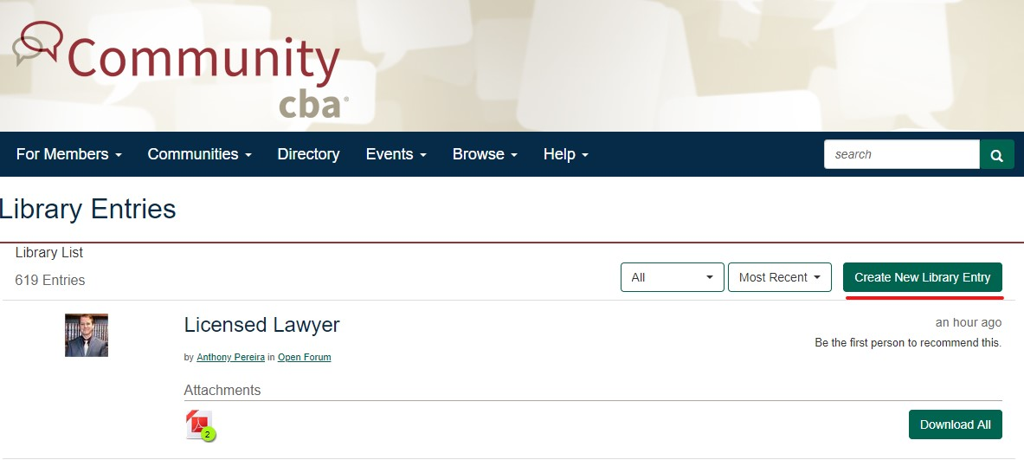
You may also create a Library Entry on this page.
Please see ‘Community Basics: Checking the Library’

Slide 16
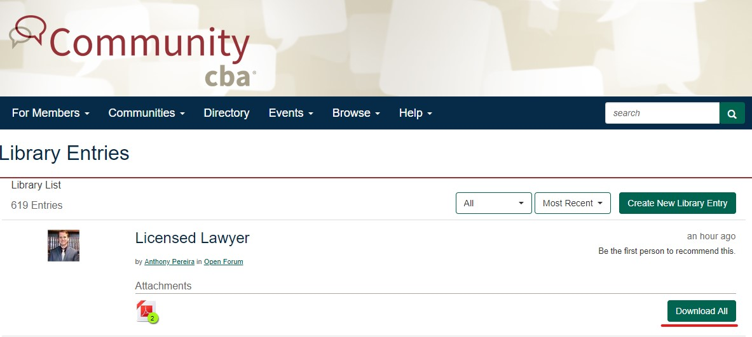
The ‘Download’ box lets you download the attachments in the specific Library post.

Slide 17
Finally the Glossary

Slide 18
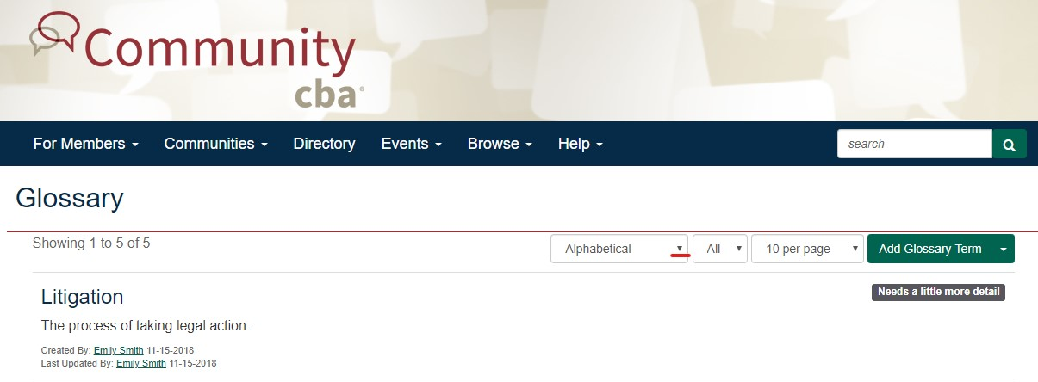
Choose the order of how you view the posts.

Slide 19

If you choose alphabetical, clicking ‘All’ with allow to narrow your search to a particular letter.

Slide 20

Choose how many posts you see per page by clicking the arrow next to ‘10 per page’

Slide 21

To add a term to the glossary, click the arrow next to ‘Add Glossary Term’

Slide 22
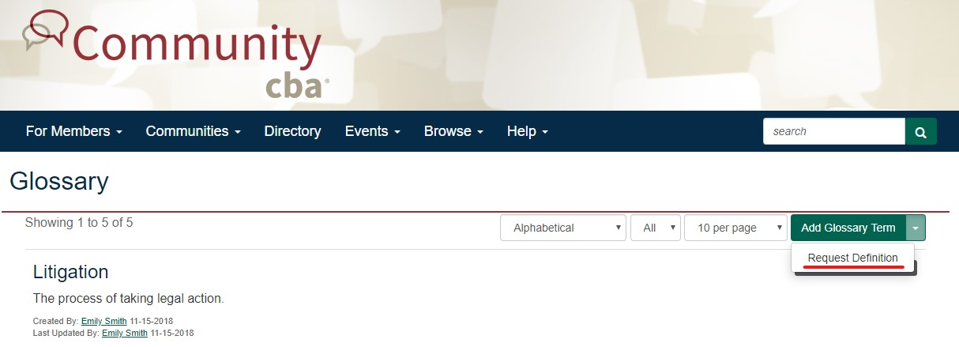
Then click ‘Request Definition’

Slide 23
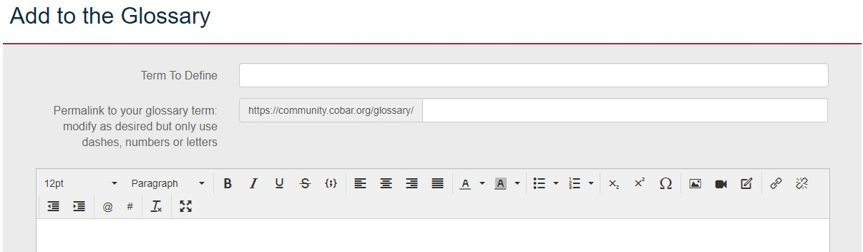
Add your desired term (into the ‘Term to Define’ line) and content (into the body of the message)

Slide 24
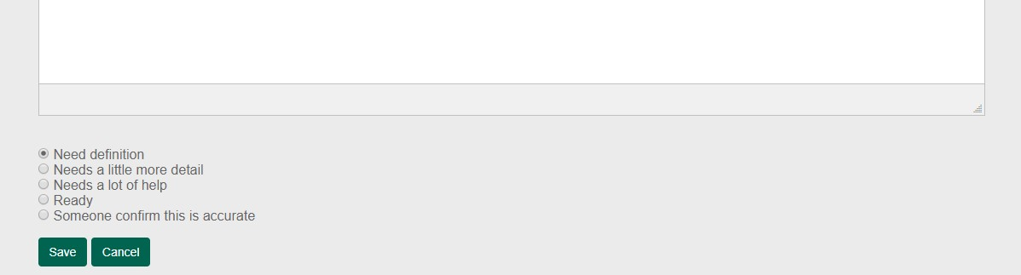
If you would like other member input on your definition choose the option from the list below that best suites the feedback you’d like. Then click ‘send’

